Slide 1
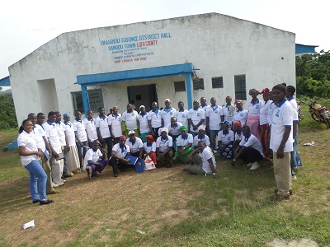
PEACE LINKS LIBERIA
Founded in 2011, is a non-profit peace-building organization striving to EMPOWER & ENGAGE community structures (women, youth, religious groups) to holistically address issues that provokes conflict and disputes to build a peaceful and inclusive society.

Slide 2
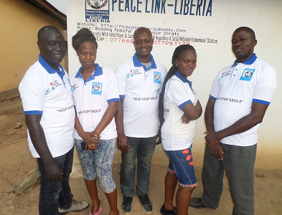
OUR MISSION STATMENT
MISSION: Volunteers in building peaceful and inclusive society
VISION: A society with peace and security everyone regardless of social status.
CORE VALUES:
UNITY
DIVERSITY
RESPECT

Slide 3
PEACE LINKS- LIBERIA ORGANOGRAM
BOARD
EXECUTIVE DIRECTOR
PROGRAM MANAGER
HEAD OF FINANCE & ADMIN
PEACE BUILDING ADVISOR
COMMUNITY EMPOWERNMENT ADVISOR
PROTECTION (WOMEN & CHILDREN)
LOGISTIC OFFICER
FINANCE OFFICER
FIELD OFFICERS
FIELD OFFICERS
FIELD OFFICERS
SECURITIES & CLEARNERS
COMMUNITY VOLUNTEERS, STAKEHOLDERS,
COMMUNITIES

Slide 4
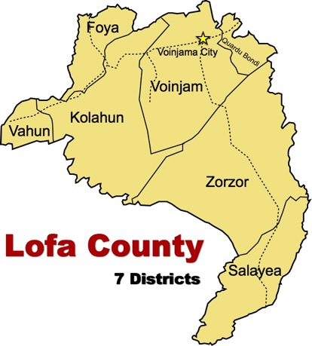
WHERE WE WORK?
FACT ABOUT LOFA
Capital: Voinjama
Population: 276,863
Towns/Villages: 946
Tribes: Mandingo, Lorma, Kissi, Gbandi and Mende

Slide 5
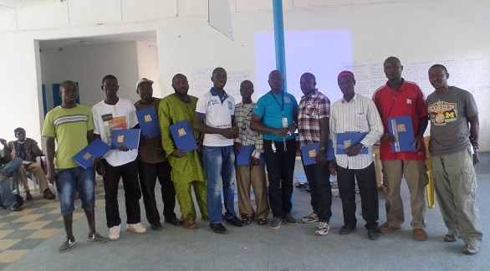
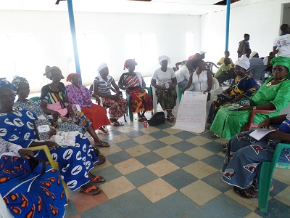
OUR THERMATIC PROGRAMS
PEACE-BUILDING & CONFLICT RESOLUTION
COMMUNITY EMPOWERNMENT
PROTECTION ( WOMEN AND CHILDREN

Slide 6
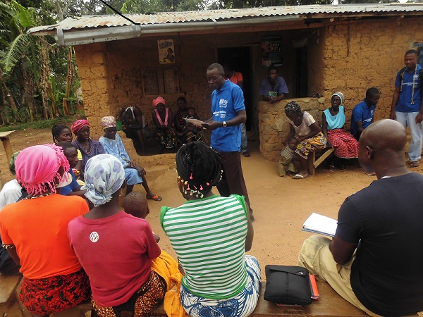
HOW WE WORK ( STRATEGIES):
PROMOTE VOLUNTEERISM
NETWORKING
COMMUNITY ENGAGEMENTS
CAPACITY BUILDING
ADVOCACY
MEDIATION

Slide 7
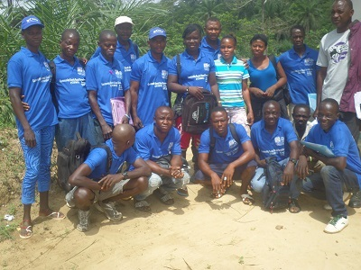
Some past projects
YEAR: 2016
PROJECT: Community Events Based Surveillance ( CEBS)
DONORS: International Organization for Migration (IOM)
Project summary: With the funding from IOM, mobilized and trained 300 community volunteers ( ages 15-year above) and 60 stakeholders ( district authorities, local chiefs and religious leaders) in Integrated Disease Surveillance and Response ( IDSR). Also provided active coaching, mentoring and supervision on trained volunteers to identify and report triggers related to health and security issues in borer communities for prompt and efficient response.

Slide 8
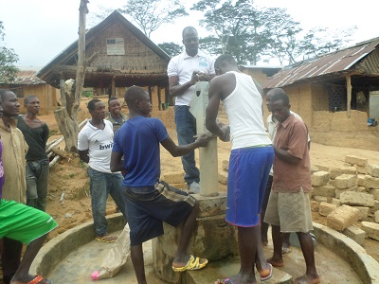
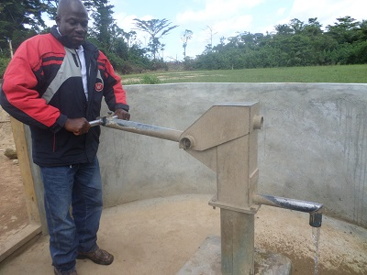
Some past project cont.….
YEAR: 2016
PROJECT: WATER SANITATION & HYGINE
DONORS: PLAN INTERNATIONAL
FUNDING PERIOD: December 2014- May 2015
Project summary: With funding from Plan International Liberia, Rehabilitated 35 water points in Ebola outbreak communities and schools. Also established pump management committees in all communities and schools with water facility.

Slide 9
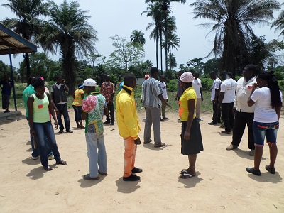
Some past project cont.….
YEAR: 2014/2015
PROJECT: Community Engagement
DONORS: United Nations Mission for Ebola Emergency Response ( UNMEER)
Brief summary: With the funding from UNMEER, Peace Links Liberia trained and engaged 200 key community stakeholders and local authorities as Post Ebola peace-building agents and border monitors to address and challenge stigma, misconceptions associated to the crisis and facilitate dialogues and mediation between affected communities, families and individuals. The project also trained 90 youth as Peer Educators to create awareness on Ebola, Peace and reconciliation in four districts in Lofa county, Liberia

Slide 10
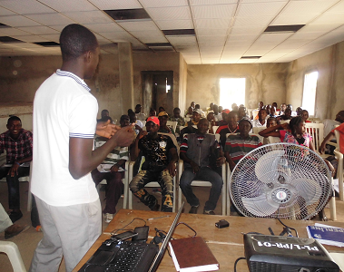
Some past project cont.….
YEAR: 2014/2015
PROJECT: Child Protection in Emergency and Psychosocial Support
DONORS: Plan International
Project summary: Provided child protection and psychosocial support training to 250 staff of local partners inter-alia social workers, animators, caregivers, child protection officers working with EVD affected children in Lofa to enhance their work with EVD affected children, survivors and orphans

Slide 11
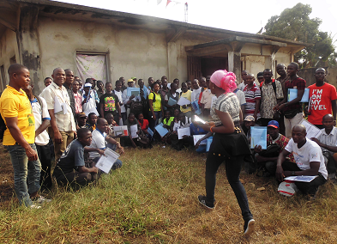
Some past project cont.….
PROJECT: Social Mobilization
DONORS: US Federal States Award
FUNDING YEAR: 2014/2015
Project summary: Trained distant and marginalized communities youths in EVD response activities, awareness creation.
Worked with local leaders, districts authorities to train and support community leaders in conflict management to mediate cases between outbreak communities, individual and families for reconciliation.

Slide 12
OUR STAFF:
NAME | SEX | AGE | POSITION | BASE LOCATION
B. MOHAMMED KAMARA | M | 35-year | Executive Director | Voinjama
MAMADEE S. KAMARA | M | above 35-year | Program Manger | Voinjama
BENDU KAWALAI | F | 32 | Finance/Admin Head | Voinjama
ALHAJDJI M. KABBAH | M | above 35-year | Logistic | Voinjama
FATU A. KEITA | F | 26-year | Administrator | Voinjama
JOMANDY B. KAMARA | M | 35-year | Field Officer | Foya District
Henena K. Ben | F | 34-year | Snr. Field Officer | Vahun

Slide 13
OUR STAFF Cont…
NAME | SEX | AGE | POSITION | BASE LOCATION
Cecellia Dawaolo | F | above 35-year | Snr. Field Officer | Kolahun
Augustine Henah | M | 35-year | Field Officer | Kolahun
Kennedy Ndorbor | M | above 35-year | Field Supervisor | Voinjama
A. Mohammed D. Fofana | M | above 35-year | M&E officer | Voinjama
Hadja Talawolly | F | 30-year | Field Officer | Foya
Musa J. Kelleh | M | 32-year | Field Officer | Kolahun
Karime A. Lamine | M | 33-year |  | Foya

Slide 14
OUR CONTACTS:
Email: peacelinkliberia@yahoo.com or peacelinksliberia@gmail.com
Website: http://www.peacelinkliberia.weebly.com
Facebook: https://www.facebook.com/peacelink.liberia
Twitter: https://twitter.com/Peacelinklib
Tel: +23177081728 or +231886684670

Slide 15
We are:
Volunteering for just peace and security for all regardless of our status.

